Slide 1
Module 2
Design principles
116N54C301

Slide 2
Design guiding principles
Categorical
Balance
Hierarchy
Scale/Proportion
Dominance/Emphasis
Similarity & Contrast.
Simple colours, minimal text and white space work together to tell a clear story.

Slide 3
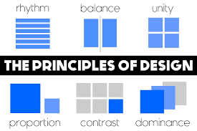

Slide 4
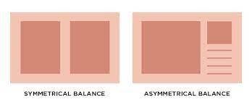
Effective Data Visualization Design principles
1. Balance the Design:
Equally distribute the visual elements like shape, colour, negative space, and texture across the plot.
Types of balances in design:
1.1. Symmetrical–Each side of the visual is the same as the other

Slide 5
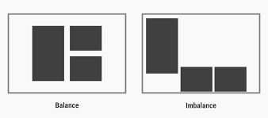
Effective Data Visualization Design principles
1. Balance the Design:
1.2. Asymmetrical–Both sides are different but still have a similar visual weight

Slide 6
Effective Data Visualization Design principles
1. Balance the Design:
1.3. Radial–Elements are placed around a central object which acts as an anchor
Option1
Main
Option4
Option2
Option3

Slide 7
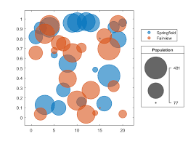

Effective Data Visualization Design principles
2. Emphasise the Key Areas
Ensure important data will not get unnoticed
Draw the user’s attention to the right data points by carefully choosing the size, colours, contrast, and negative space.
Negative Space

Slide 8
Effective Data Visualization Design principles
3. Illustrating Movement
Movement directs the user’s attention in a certain direction
Visual elements should mimic movement in an “F” pattern, which is how people read.
Starting from top left to right, and gradually down the page.
1 2 3
4
5
6

Slide 9
Effective Data Visualization Design principles
4. Smart Use of Patterns
Repeated design elements form a pattern.
Patterns make for a great way to display similar types of information spread across the page as one.
Using similar colours, chart types and elements are the way to go.
Easier to communicate an anomaly, since any disruption in the pattern will naturally draw the viewer’s attention and curiosity.
Using patterns is one of the simplest and most effective design principles when it comes to data visualization.

Slide 10
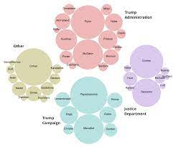

Effective Data Visualization Design principles
5. Proportion
Proportions can indicate the weight of different data sets and the relationship between their values.

Slide 11
Effective Data Visualization Design principles
6. Proper Rhythm
Balanced rhythm when the design elements together create a pleasing movement to the eye

Slide 12
Effective Data Visualization Design principles
7. Variety
keeps viewers engaged and interested
not only eye-catching but also helps the viewer retain the information presented for longer.
Use apt type of visuals , graphs suitable for the purpose

Slide 13
Effective Data Visualization Design principles
8. Theme
Design is consistent and follows a standard.
Incorporate a theme for company or based on the niche of the visualization.
This helps connect with the user on a deeper level and augments the visual design.

Slide 14

Gestalt Principles
Proximity:
The nearer the objects to each other, the more we logically think that these objects belong to the same group
placing visuals closer together encourages the users to think that the grouped visuals are in the same context.
The way the objects are positioned in relation to each other can also make the user unconsciously move their eyes from left to right and/or top to bottom.
Notes:
What do you see? 12 blue circles or 2 columns of 6 circles each ?

Slide 15
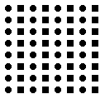
Gestalt Principles
Similarity:
Objects of the same color, size, shape and orientation belong to the same group,
Notes:
Human automatically group the patterns as circles, squares and octagaons

Slide 16
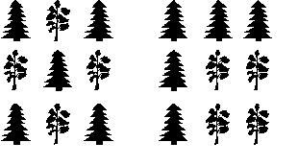
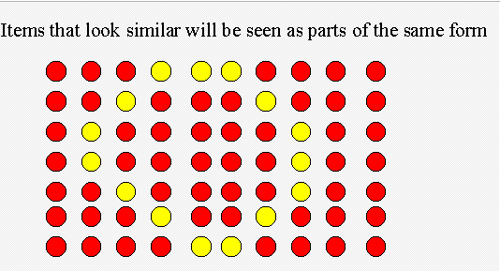
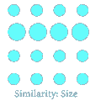
Gestalt Principles
Similarity: Shape, Scale and Color
Grouping:
Similarity:

Slide 17
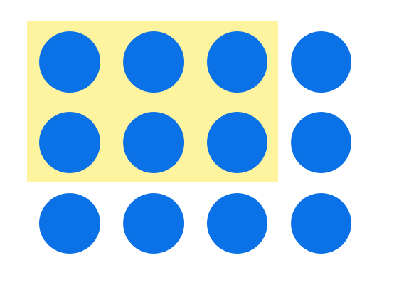
Gestalt Principles
Enclosure:
A group of objects can be enclosed by anything that forms a visual border around them
This enclosure causes the objects to appear to be set apart in a region that is distinct from the rest of what we see.

Slide 18


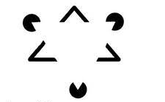
Gestalt Principles
Closure:
Our eyes tend to add any missing pieces of a familiar shape

Slide 19
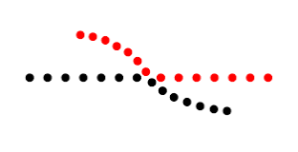

Gestalt Principles
Continuity:
We perceive objects as belonging together, as part of a single whole, if they are aligned with one another or appear to form a continuation of one another.
It’s like the closure principle, but besides the visual connection to form shape, we also attach visual direction as part of the continuation.

Slide 20
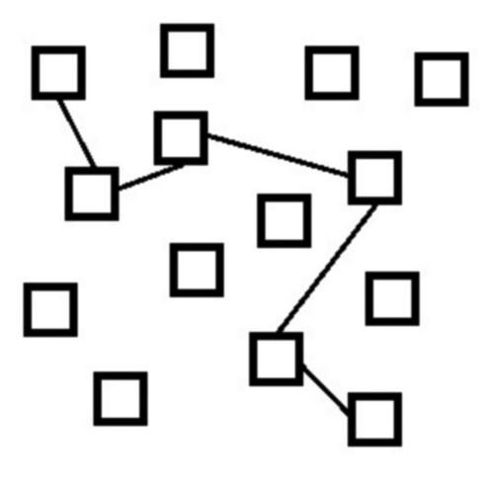
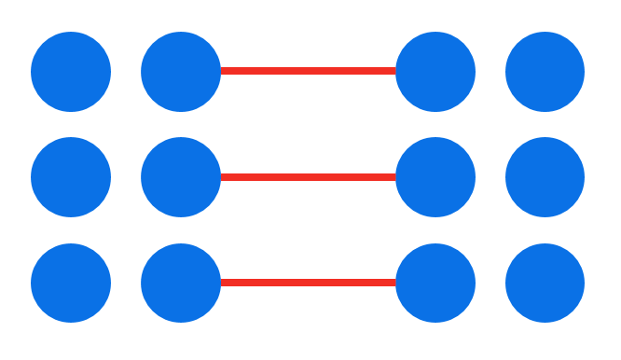
Gestalt Principles
Connection:
We perceive objects that are connected in some way, such as by a line, as part of the same group

Slide 21

Gestalt Principles
Figure and Ground
We add information based on our imagination

Slide 22
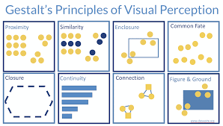

Slide 23
7 Key Design Principles
Identifying The Target Audience
Be clear on the target market and their levels of literacy
Have a good idea of the message or messages they want to convey.
Take into account ethnicity and cultural values.
2. Focusing On Focus
Create a visual hierarchy or focus on key areas using : size, contrasting colors, and position.
Take into account “eye flow”, the way the eye moves from left to right and then down and left to right again.

Slide 24
7 Key Design Principles
3. Keeping It Simple
Break data down into digestible bites
Make information easy for people to understand at a quick glance
4. Balancing Layouts
Balanced and elegant presentation accomplished by using a grid as the underlying skeleton of the design.
A common element used are columns to organize information, much like the style of newspapers, magazines, and documents.

Slide 25
7 Key Design Principles
5. Organizing Alignment
Group related content together and separate unrelated content
Use lines, backgrounds, and boxes to show connections or related content.
Separate unrelated information using spacing and enclosures, such as boxes, color, and backgrounds.
6. Creating Consistency
Design elements must all remain the same , use standard font and point size
Consistent use of color for graphical elements, and keeping an eye out for consistency in the visual hierarchy.
Stick to a considered design standard if the client has a corporate identity or branding guidelines . Balanced and elegant presentation accomplished by using a grid as the underlying skeleton of the design.

Slide 26
7 Key Design Principles
7. Elevating Engagement
Form should follow function.
Consider balance, movement, and interactivity.
Keep the target audience interested, engaged, and invested in the message means success.

Slide 27
Time series based design principles
Time series data is any type of information presented as an ordered sequence
Collection of observations for a single subject assembled over different, generally equally spaced, time intervals.
The time intervals applied to assemble the collected data in a chronological order are called the time series frequency.

